Slide 1
GLOBALPROFILEFRAMEWORK
-a DECLARATIVE APPROACH
November 30, 2018

Slide 2
GPF Objectives
To externalize all the rules and make it declarative so that it can be changed easily.
But creating or modifying the rule is difficult and time consuming.
Also developer should have in-depth understanding of each rules – Makes hard for any new developer.
Its not flexible. It is more of product where we have to align with rules, Or custom rules has to be generated for any new business changes.
Developers are not handy/close to the validation rules
To remove region/country specific validation rules implementation from CAP services source code.
Yes. NA Team approach is defining the region/country specific implementation at higher level.
To reuse validation rule implementation in all applicable services.
Yes. NA Team approach also reusing the validations with more readability and easy to change.

Slide 3
Current Approach
Region specific validation rules are embedded in code.
Yes.
Results in code change when new regions are added to the CAP services.
Yes
Disadvantages
Maintenance of code becomes difficult when more regions are getting added.
Codes are completely decoupled wrt tenants. Makes easy to adapt any changes wrt tenants. At the same time, validators are reused wherever applicable.
May result in injection of bugs for a region due to the change in code for another region.
No. Each tenant has its own flow. A change request in any validator used by different tenants leads to new validator for that change. So existing wont be impacted at given time.
Reduced code readability and maintainability.
No. Its plain generic java flow. Easily understandable by any developer.
Redundant code and which in turn increase the frequent code change.
No redundancy. Codes are reused all the times.
Code cannot be reused based on scenarios/regions.
Defining the initial path is sufficient. Rest all validations are reused.
Reduced performance.
Reaches the max effort in doing the things parallel with more readable, flexible and less maintenance.

Slide 4
Proposed Approach – GlobalProfileFramework
Validation rules implementation logics are removed from the services.
These custom rules are harder to maintain.
Global profile framework is maintained as a jar.
All the rule execution code is made independent and can be embedded as a jar in any services irrespective of the region.

Slide 5
Aggreed Approach Vs GlobalProfileFramework Approach
S.No | New Agreed Approach | Declarative Global profile Framework Approach
 | Advantages of global profile Framework
1 | Business Rules are embeded in code and it's very hard to maintain. | Business rules are declaratively configured and it's easy to Maintain.
2 | Business rules implemetations are duplicated in all services | Business rules implementions can be reused in all services by applying them through configurations
3 | Different implemetation code for multiple markets make code clumsy, not easy to understand and hard to maintain. | Can Support Multiple markets Business rules easily , as the only change required is configuration change in JSON file. No code change is required.
4 | Increase the effort needed to support global markets. | Reduces the effort needed to support global markets to a large extent.
5 | A change in business rule does neccesiate code change. | A change in business rule does not neccesiate code change.
6 | N/A | Json configuration file is with the service and not within the framwework Jar.So, for rule changes , changes are need in the service alone ane not in the framework jar.
7 | N/A | Can handle any current service input objects and future service inputs objects without any change in the framework jar.
8 | N/A | Addition, deletion and updation of fields in the service inputs does not need changes in Framework. The frameworks does not have any references to Service input classes
9 | Does not execute all business rules in parallel( Only code table look ups are performed) | Bsuiness rule executions are performed in parallel to improve performance.
10 | Increase effort when the application needs to support multiple regions in globle. Deveveloper need to go through the code to understand existing code and add new rultes. | Reduces the effort needed to support global markets. Developers does not need to go through the existing code to understand existing rules. They can simply change/add fields and rules in json.
11 | Increases the amount of junit test cases needed to be written as new regions are due to | Reduces the amount of junit testcases needs to be written to support multiple region business rules.
12 | Need to write lot of junit testcase as new regions(with differnet business rules) are added. There will be code changes needed to support new region and for that Junit testcases needs to be written. | No need to write lot of testcases asr new regions(with different rules) are added. There will be no code change to support new region as the rules are in the Json.
13 | It's very hard to understand the the service code that embeds business rule than framework code . These kind of code makes developers scary when changes need to be peformed in the production launch periods | It's very easy to understand the framework code than understanding the service code that embeds business rule. NA implemention of MA is one such example.
14 | Rules in code cannot be understanbale/updatable by the non- technical people. | Even Non technical people can understand and Update rules in JSON document as it is very easy to undertand.
15 | N/A | New Rule types can be implememted in the framework and resused by all services. Extending the reusuability of code
16 | Code java's feature to implement the asynchronous execution make the code not easy to read as the Spring's implementation. | Uses Spring's feature to implement asynchronous execution. It is easy to understand and keeps the code neat and clean.
17 | No expliit Thread pool is configured | Thread pool is configured and used to reuse the resources to improve performance.
18 | Due the usage of core java feature For Asynchronous implementations, MDC context( to hold Trace id and SpanId ) is scattered across method implementations as method parameters in many methods. | Due to the usage of Spring's feature , MDC context( to hold Trace id and SpanId ) is injected from one place through task decorator . This avoids scattering MDC context as mehod parameters in many classes
19 | Service Will not give consistent error Response when there more than one validation errors occurs | Service will Give consistent error response even when there are more than one validation errors

Slide 6
GlobalProfileFramework-Work Flow
Notes:
Target finish within 15 mins.

Slide 7
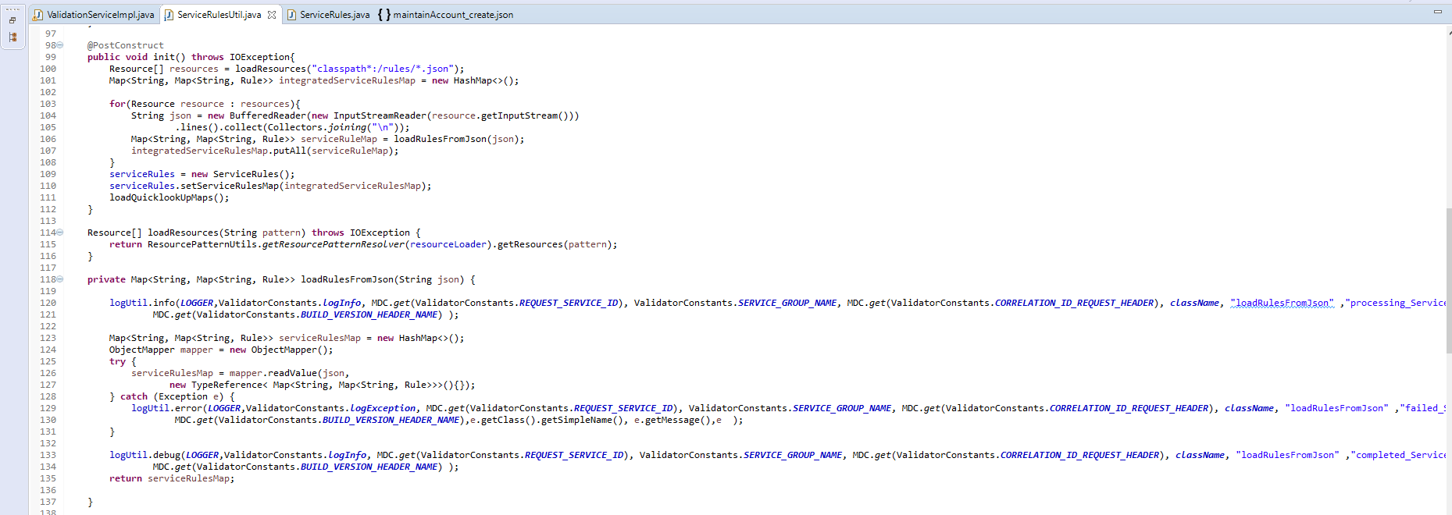
GlobalProfileFramework-Rules Based Approach
Rules that are defined in the calling service classpath are loaded on application start up based upon their service and operation name combination
ie Map<String, Map<String, Rule>> serviceRulesMap = new HashMap<>();
Key : maintainAccount:::create, Value : Map <CountryName(USA) , Rule>
Notes:
Target finish within 15 mins.

Slide 8
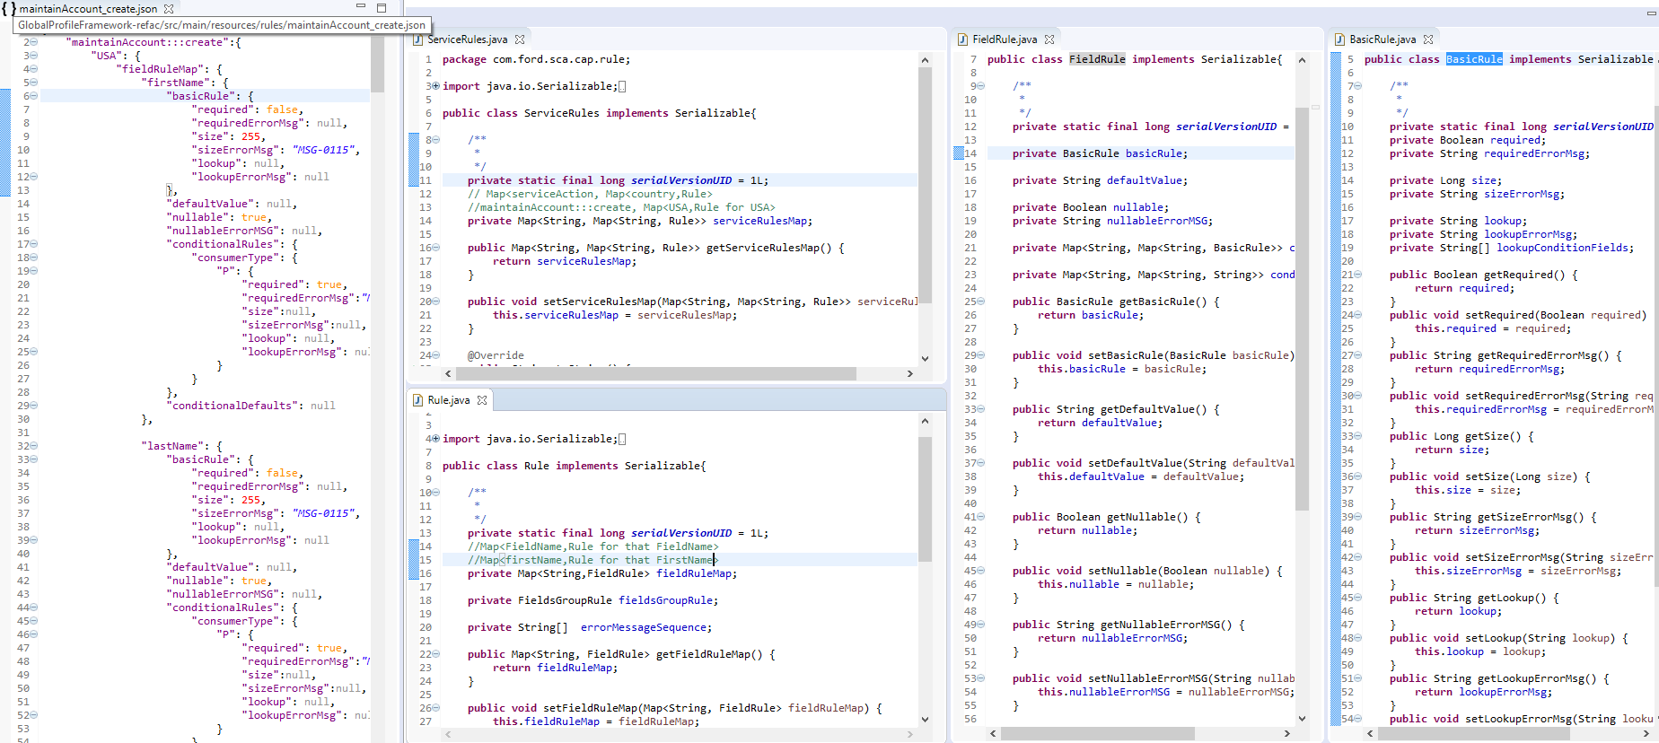
GlobalProfileFramework-Rules Based Approach Contd…
Notes:
Target finish within 15 mins.

Slide 9
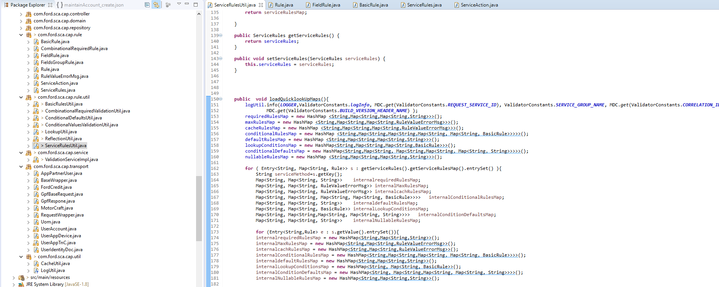
GlobalProfileFramework-Rules Based Approach-Contd…
The rules are further segregated into different maps based upon their validation functionality
Notes:
Target finish within 15 mins.

Slide 10
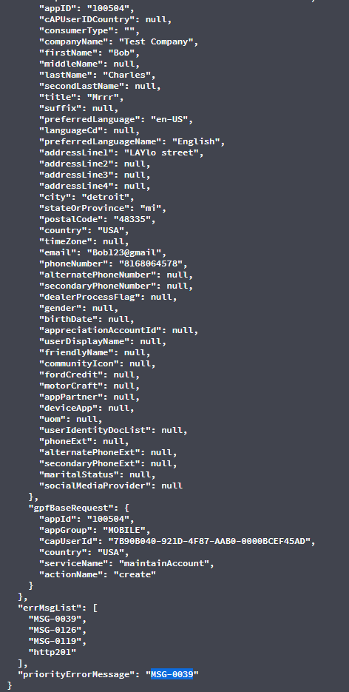
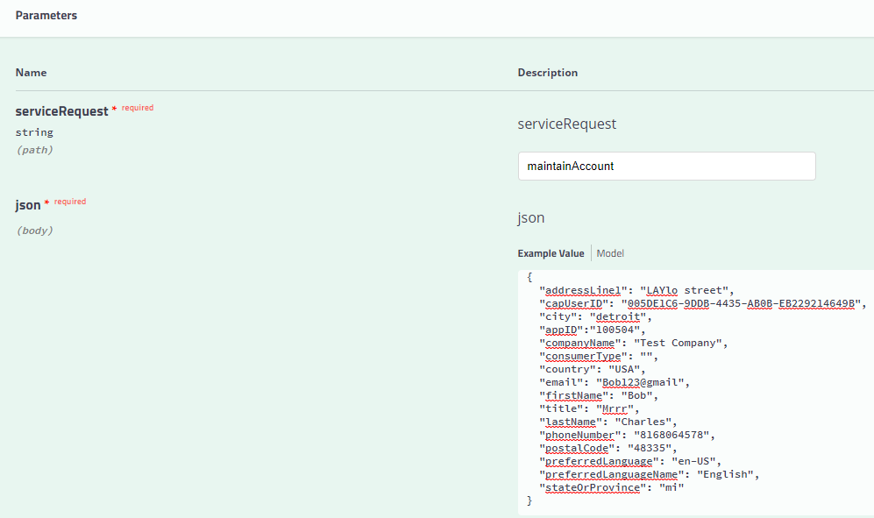
GlobalProfileFramework-Sample Result
MaintainAccount Service calls GPF with consumerType as empty and GPF inturn returns a priority error msg as “MSG-0039”
Notes:
Target finish within 15 mins.

Slide 11
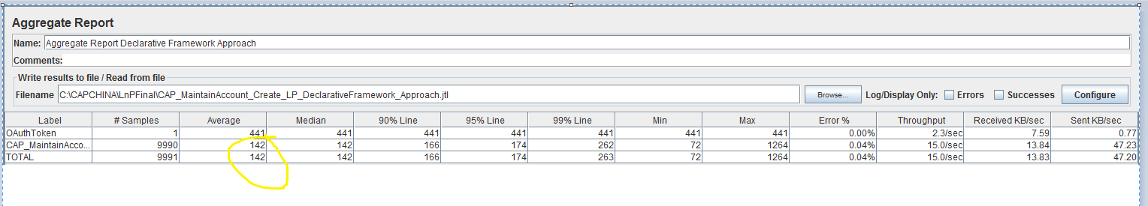
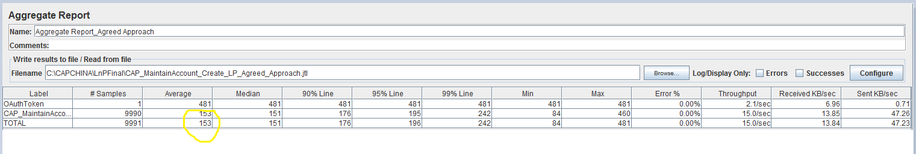
GlobalProfileFramework-LnP Results
Done L&P testing of MaintainAccount with declarative global profile framework (142 Milliseconds) and the results are identical to the results of MaintainAccount with Already agreed new Design(153 Milliseconds). Please see below screenshot of the LP test results of the Declarative global profile frame work.
Notes:
Target finish within 15 mins.

Slide 12
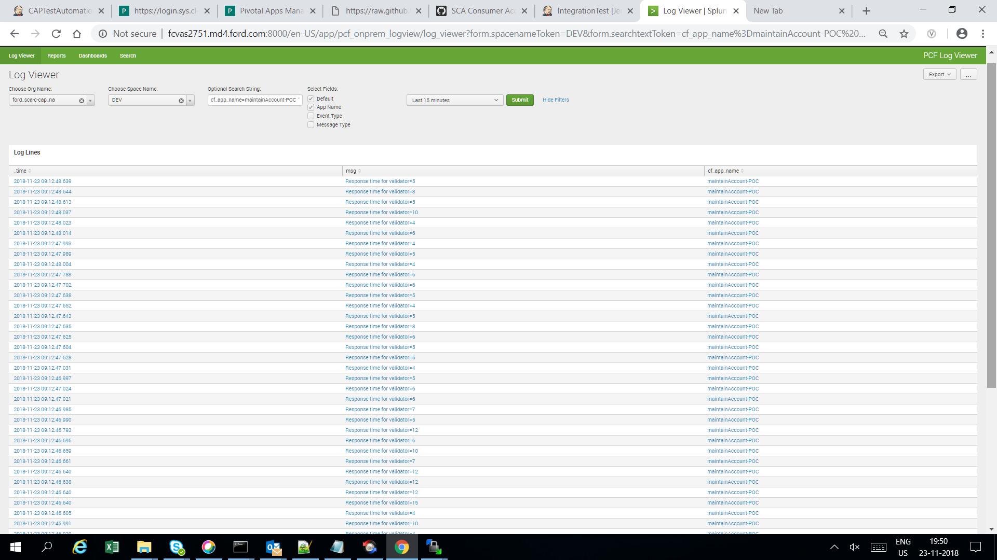
GlobalProfileFramework-Splunk Report
Splunk report that shows time taken by global profile framework in milliseconds
Notes:
Target finish within 15 mins.

